Slide 1
Alojz Gomola
Rules of the Air within Reach Set SAA
4th April 2018
Progress report on framework development

Slide 2

Rules of the Air Context Introduction

Slide 3

Framework
We have this architecture:
ADS-B
Obstacle Map
LiDAR
Rule Engine
Data fusion
Mission Plan
Avoidance grid
Let us focus on Rules
Vehicle control
Movement Automaton
Reach set estimation
Notes:
Rule engine then selects goal of avoidance and Next decision point (There is primitive hard-coded set of rules)
Avoidance grid have been fully implemented and tested for simple plane model in Matlab

Slide 4
Covered Functionality
Reach set based framework covering:
Path planning,
Evolving world,
Adversarial,
Data fusion,
Static restrictions,
Weather,
Rules
ADS-B
Obstacle Map
LiDAR
Rule Engine
Data fusion
Mission Plan
Avoidance grid
Vehicle control
Movement Automaton
Reach set estimation
Notes:
Rule engine then selects goal of avoidance and Next decision point (There is primitive hard-coded set of rules)
Avoidance grid have been fully implemented and tested for simple plane model in Matlab

Slide 5
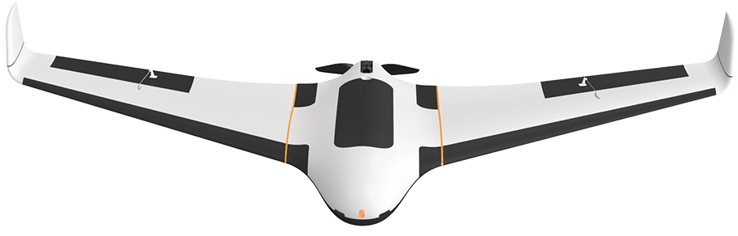
Current Architecture in Nutshell
We have standard noncooperative framework
based on Reach Sets
UAV 1 (S-Rotor)
Navigation Grid
Mission Control
Mission Control responsible for:
Waypoint management,
Priority checkup,
Vehicle safety.
Navigation Grid responsible for:
Navigation in open space.
Avoidance Grid responsible for:
Intruder avoidance
Obstacle avoidance
Avoidance Grid
UAV 2 (FACAS)
Navigation Grid
Mission Control
Avoidance Grid

Slide 6
Avoidance in the nutshell
What is a reason to have
two separate grids ?
UAV 1 (S-Rotor)
Navigation Grid
To separate:
Event based avoidance
When sky is clear we can consider to apply man made rules.
Situation based avoidance
When situation arises, we need to protect ourselves
Mission Control
Avoidance Grid
Preemptive based
Event based
Situation based
Well defined Waypoints
Free Space guarantee
Preflight preparation
Legal compliance
Targets of avoidance:
Cooperative intruders (Rules of the air)
Bad weather
Geofencing
Targets of avoidance:
Non-Cooperative intruders
Terrain
Other physical obstacles

Slide 7
UTM Module Introduction
We have standard noncooperative framework
based on Reach Sets
UAV 1 (S-Rotor)
Navigation Grid
Mission Control
There is need for
UASTrafficManagement (UTM)
provide C2 link and
cooperative functionality
Avoidance Grid
UAV 2 (FACAS)
UAS Traffic Management
Navigation Grid
Mission Control
One module to rule them all
(USpace EU, UTM US)
Avoidance Grid

Slide 8
Which Functionality is Provided by UTM
Traffic management responsibilities (selected):
Separation – keep all airspace users (manned/unmanned) Well Clear.
Collision prevention – prevent collision and enforce rule compliance.
Conflict resolution – the UTM decides request satisfaction based on rules.
Separation:
Controlled Airspace is segregated into Flight Levels by 1000 feet's of Barometric Altitude (ASL).
Each Flight Level is considered as separated space with planar routing.
UAS can induce climb/descent maneuvers in local level altitude 250-750 feet
UAS must ask for a permission to change flight levels and reserve multiple levels during take of and landing
UAS must stay “Well clear” from any other traffic considering protection tube with given own radius (intruder radius)
ACAS-XU defines such separations

Slide 9
Collision Prevention
Collision prevention is based on aircraft mode:
Descending – aircraft is changing flight levels from higher to lower during landing maneuver or during required descent given by flight plan.
Climbing – aircraft is changing flight levels from lower to higher during take off maneuver or during required ascend given by geographical features.
Loitering – aircraft is moving in same flight level (We will focus on this part), aircraft is required to keep:
Horizontal separation – avoid protection range of other aircrafts on same level
Vertical separation – avoid entering to protected zones of flight level (0-250 feet, 750-1000 feet) of local altitude in flight level.
Note: EuroContol/EASA separates flight levels based on barometric pressure in controlled region, therefore aircraft needs to have barometric altitude measurement equipment to fly in Controlled Airspace.

Slide 10
Conflict resolution
Conflict resolution is Event-based depending on proclaimed aircraft position, heading and velocity, and classification.
Collision Case is created for two conflict participants (for both):
Position (Latitude, Longitude, Flight level).
Velocity (Vectorizer, Planar),
Vehicle Category (Size/Maneuverability)
Trajectory Prediction (Planned/Predicted)
Collision point (Based on possible trajectory intersection)
Angle of Approach (to adversarial vehicle)
Collision type (Based on Angle of approach)
Avoidance role (Based on previous data and decision algorithm)
Note: This work is focused on resolution of Loitering incidents in same flight level. The UTM have final decision on Collision case opening/closing.

Slide 11
How is Collision Case resolved by UTM
Each vehicle is calculating Collision Cases to nearby vehicles,
UTM is also calculating Collision Cases to nearby vehicles,
UTM issues Resolution advisories or separation rules to prevent collision
Resolution
UAV 1 (S-Rotor)
Mission Control
Navigation Grid
Collision Case
Position notification
UAS Traffic Management
UAV 2 (FACAS)
Position notification
Mission Control
Navigation Grid
Resolution

Slide 12
What is Considered in UTM Resolution
What is considered in UTM Resolution processing:
Vehicle category (higher category is always favored)
Vehicle maneuverability (higher maneuverability is forced to avoidance)
Collision Point surroundings (other collision points in proximity)
Other Collision Cases related to aircrafts in current collision case or collision point.
The expected behavior of UAV platform is given by following table:
Intruder | Our vehicle | Priority
Manned aircraft | Any UAV | Manned aircraft
VLOS piloted UAV | VLOS piloted UAV | Coordinated avoidance
VLOS piloted UAV | Autonomous UAV | Autonomous UAV
Autonomous UAV | Autonomous UAV | Coordinated avoidance

Slide 13
Vehicle Category/Maneuverability
From highest to lowest:
Manned aviation in distress,
Balloon (manned),
Glider (manned),
Aerial towing (manned)
Airship (manned)
Other manned aviation
UAS Autonomous
RPAS
Note: This categorization reflects only Pilot community statement, the general priority rule is broken, because maneuverability and vulnerability should be always considered as ked decision factor.
From highest to lowest:
Altitude control (Balloon, Hovering aircraft)
Full control – no propulsion (Gliders of any sort)
Full control – gliding (Any aircraft of plane type)
Full control – VTOL (Any aircraft with VTOL )
Note: This categorization with vehicle cruising/maximal velocity should be main decision matter.
Original categorization is based on maneuverability (extended not)

Slide 14
Right of the Way Rules
Right of the way rules aid pilots in avoiding each other visually
The rules are found:
Part 91 Federal Aviation Regulation (USA)
ICAO Annex 2 -> Chapter 3 - General Rules -> 3.2 Avoidance of collisions -> 3.2.2 Right of way (International)
When aircrafts are converging, the right of way is generally given to the least maneuverable aircraft (higher class)
The aircraft now having the right of the way is to pass well clear of the aircraft not having the right of the way
Application for rules of the air in case of UAV seems to be reduced to immediate avoidance in case of manned aviation adversary
The avoidance rules can be applied between the same class of UAV

Slide 15

Rule Engine

Slide 16
Rule Engine Introduction
Rule Engine – configurable engine weaved into UTM, Mission Control, Avoidance Grid, Reach Set classes to enrich existing functionality.
Joint Point – point in process where rule engine is invoked,
Context – context passed to rule body
Rule – small piece of functionality
Rule Engine
Joint Point
Context
Rule

Slide 17
Rule Engine Architecture
Context
Gather
Context
Rule Engine
Invoke
Engine
Joint Point
Mission Control
Rule
Navigation Grid
My mission
Velocity Recalculation
Invoke Rule Instance
Parser
Check condition:
Intruder Velocity
Application
Parse context:
Intruder Position
Take action:
Slow down
Condition

Slide 18
Rule Engine in Nutshell
Benefits, modularity, scalability rule chaining etc …

Slide 19
Rule Engine Joint Points

Slide 20
Rule: Disable Left Plane Heading

Slide 21
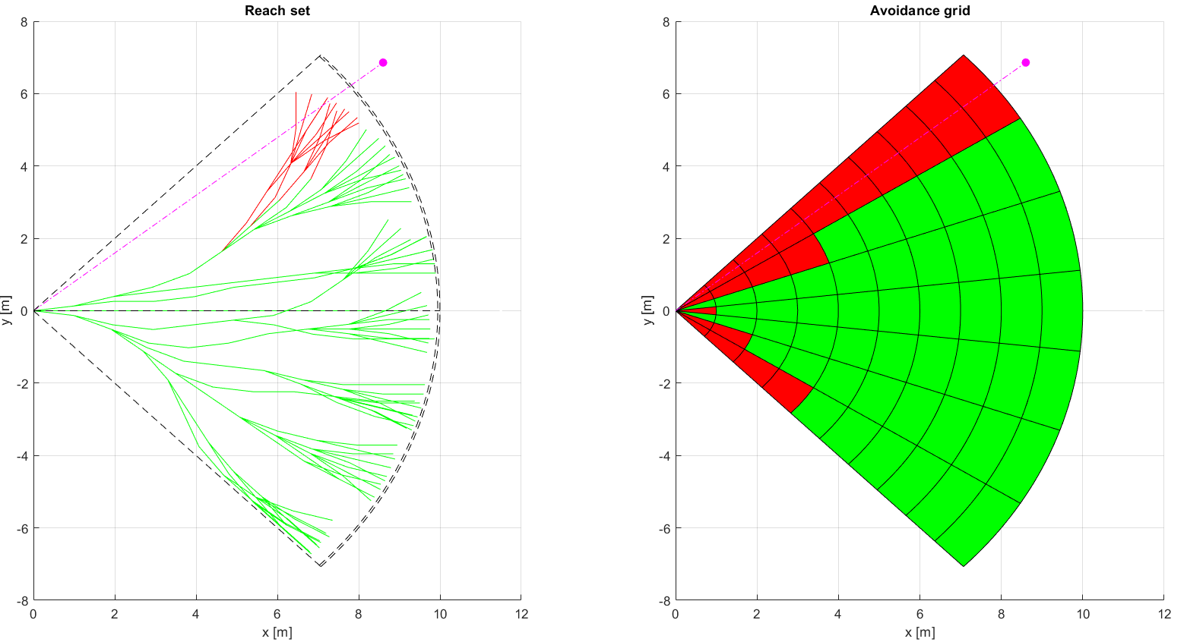
Disable Left Plane Heading (1)

Slide 22
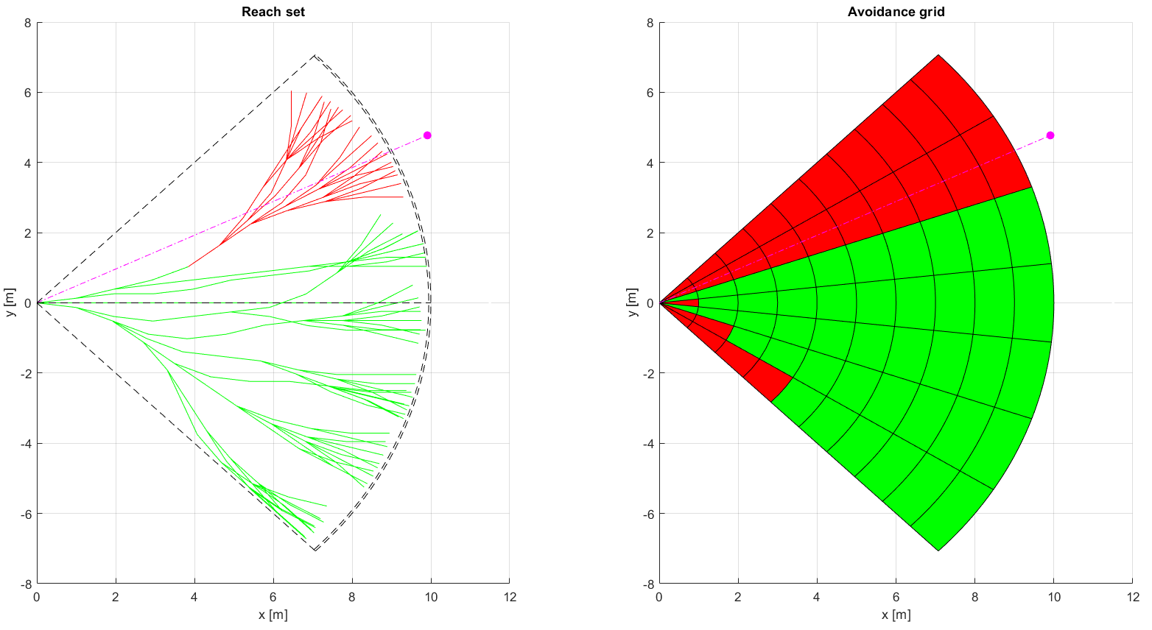
Disable Left Plane Heading (2)

Slide 23
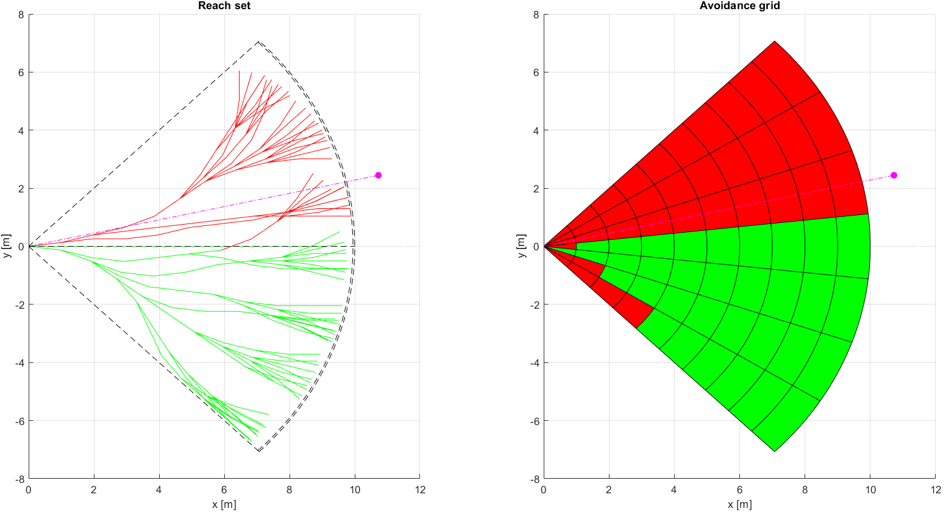
Disable Left Plane Heading (3)

Slide 24
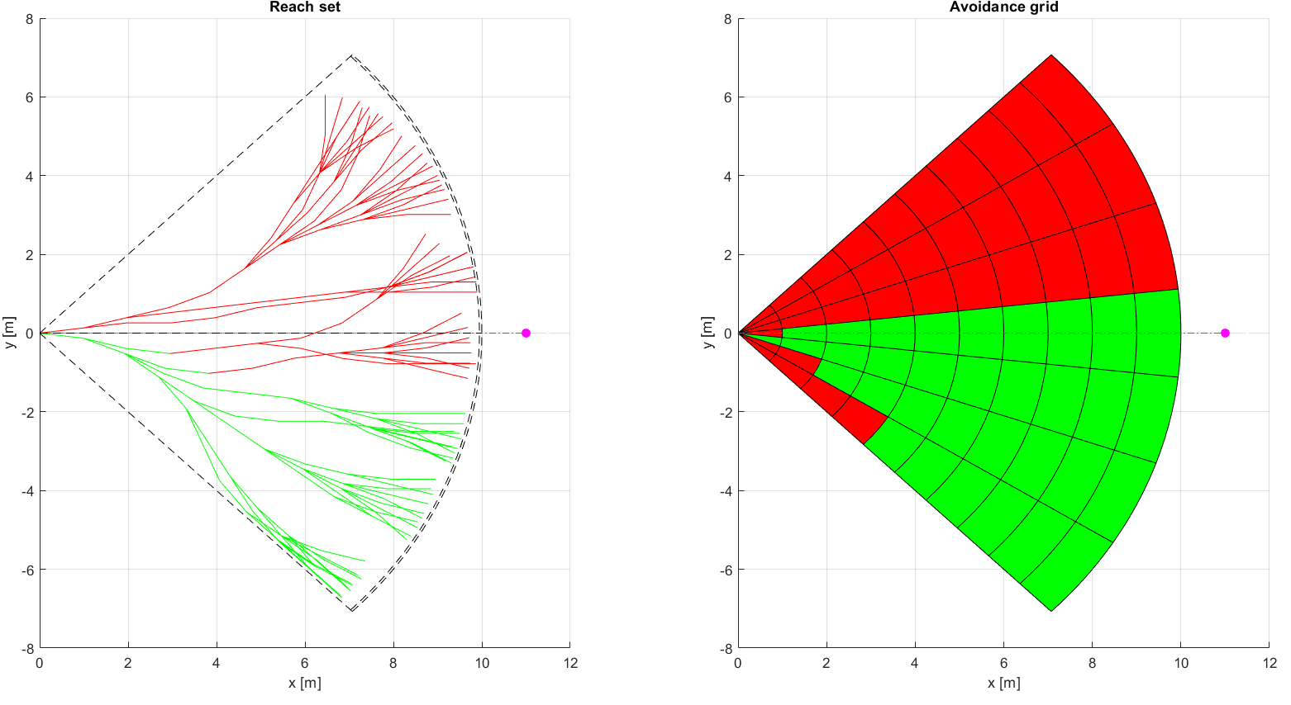
Disable Left Plane Heading (4)

Slide 25
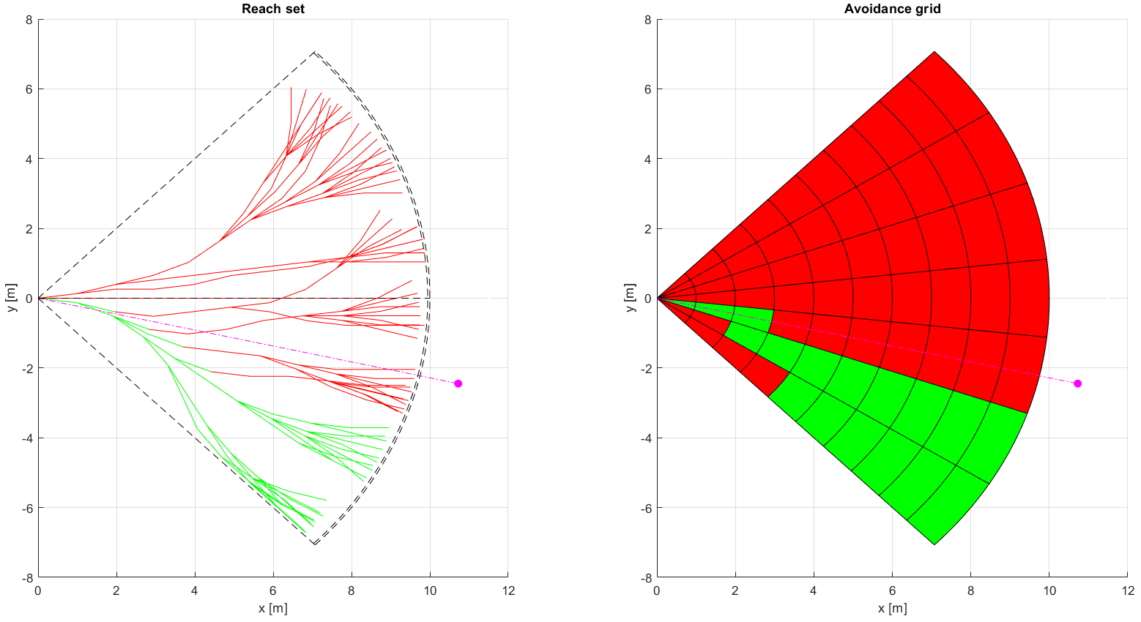
Disable Left Plane Heading (5)

Slide 26
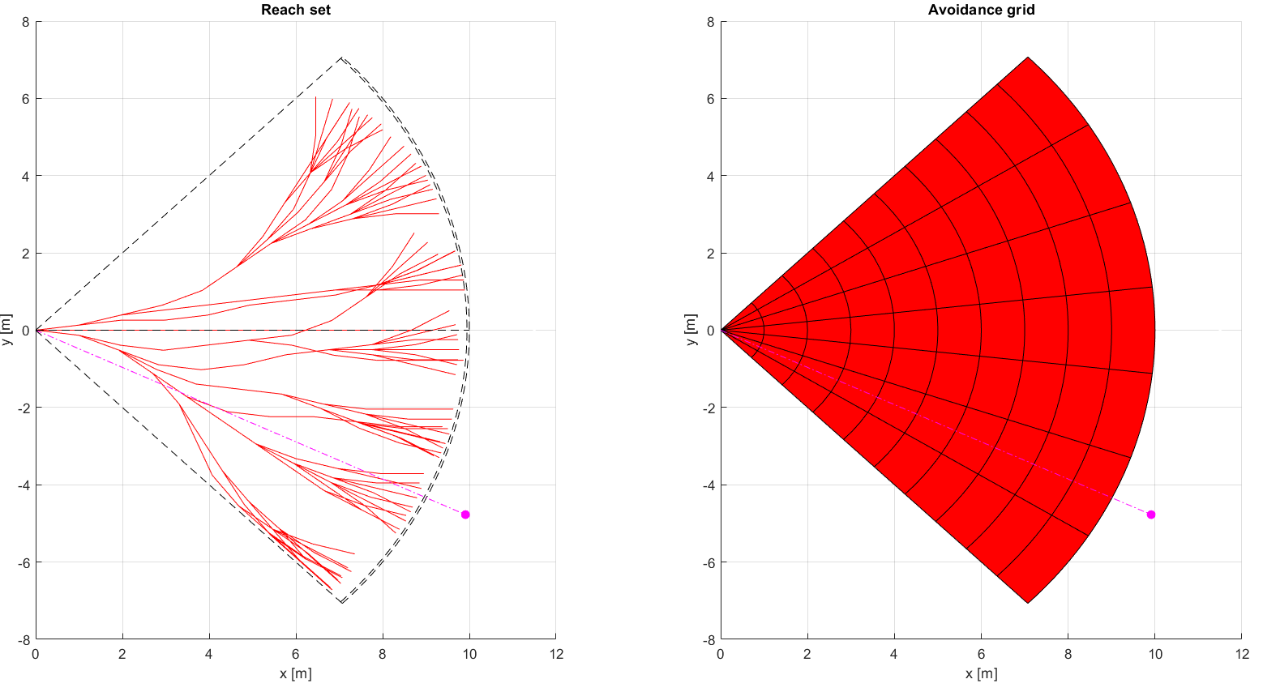
Disable Left Plane Heading (6)

Slide 27

Disable Left Plane Heading (7)

Slide 28
Rule: Enforce Safety Margin

Slide 29
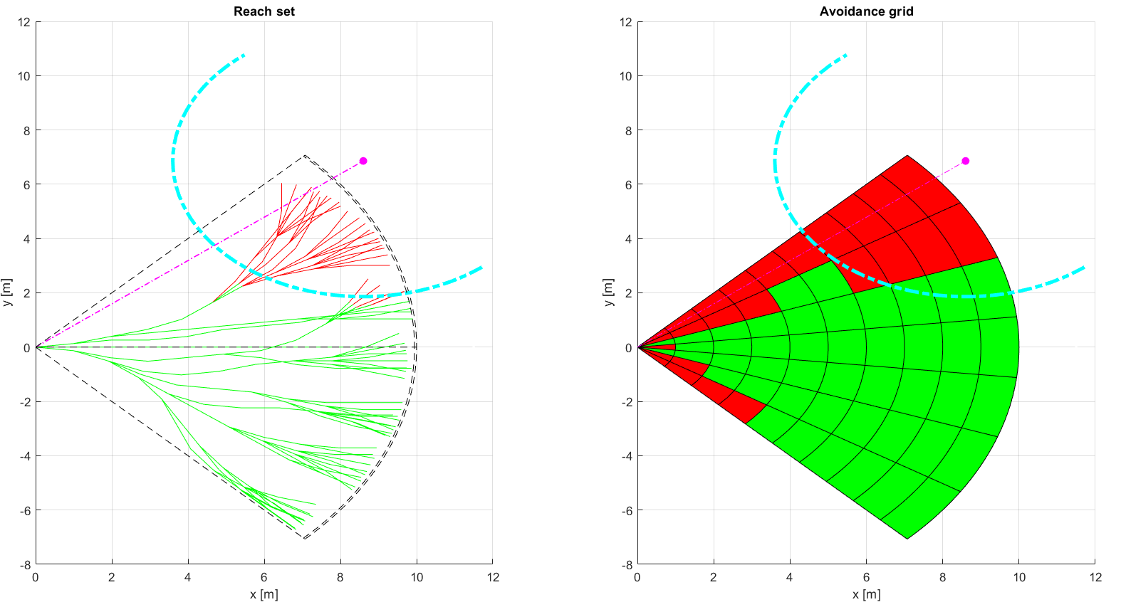
Enforce Safety Margin (1)

Slide 30
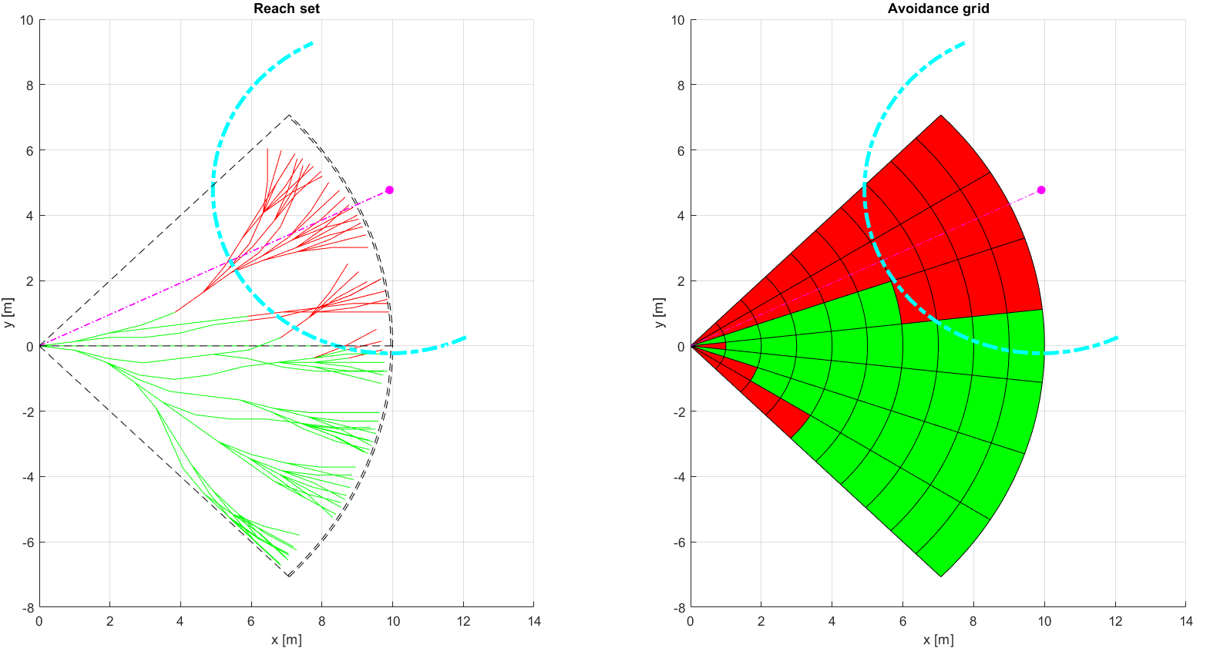
Enforce Safety Margin (2)

Slide 31
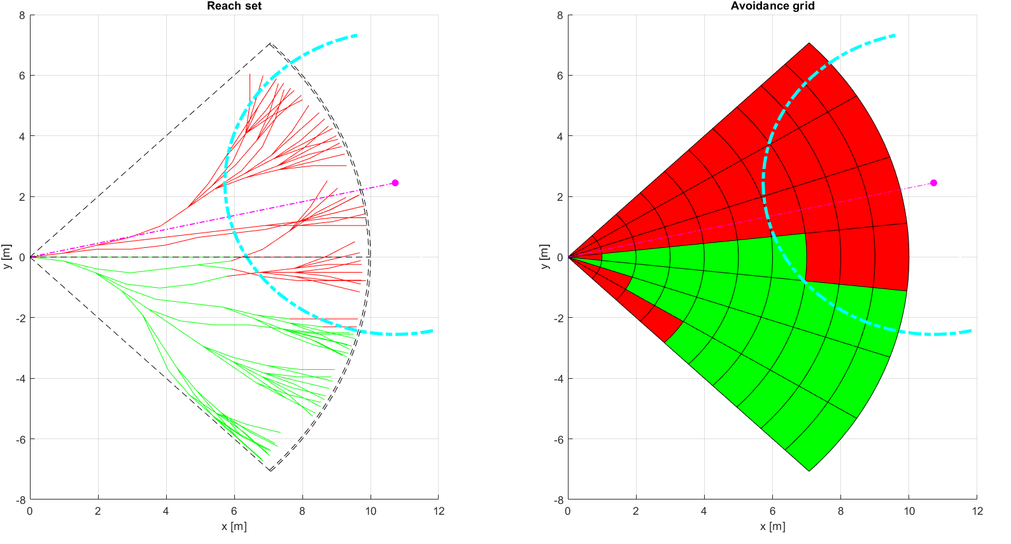
Enforce Safety Margin (3)

Slide 32
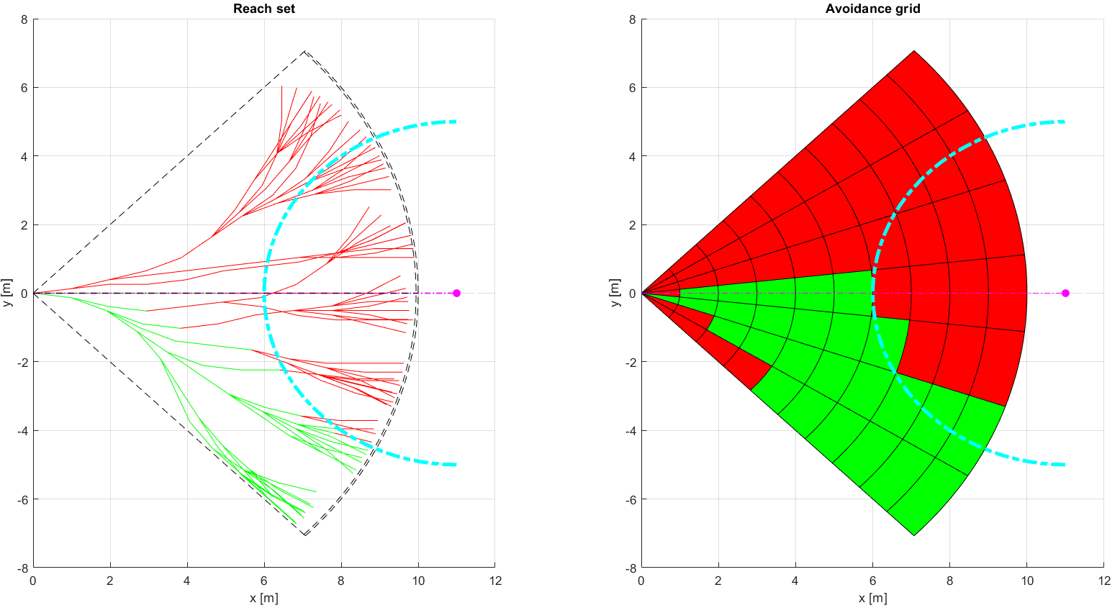
Enforce Safety Margin (4)

Slide 33
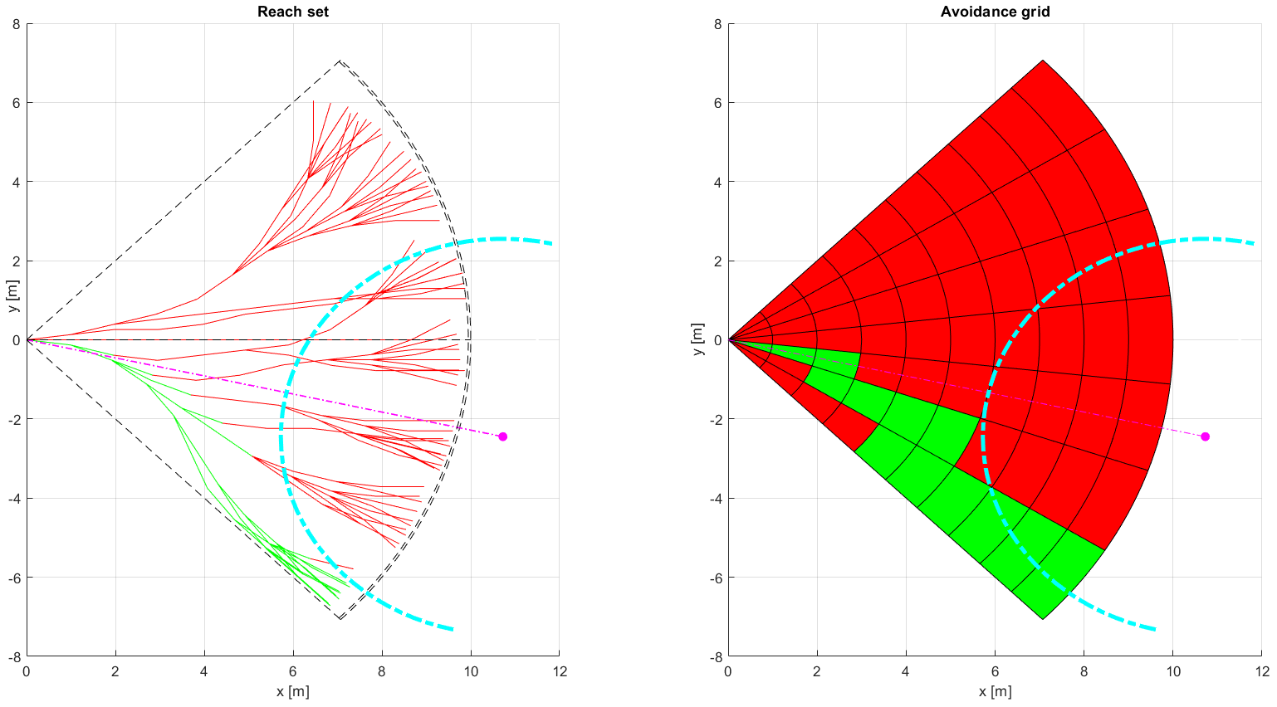
Enforce Safety Margin (5)

Slide 34
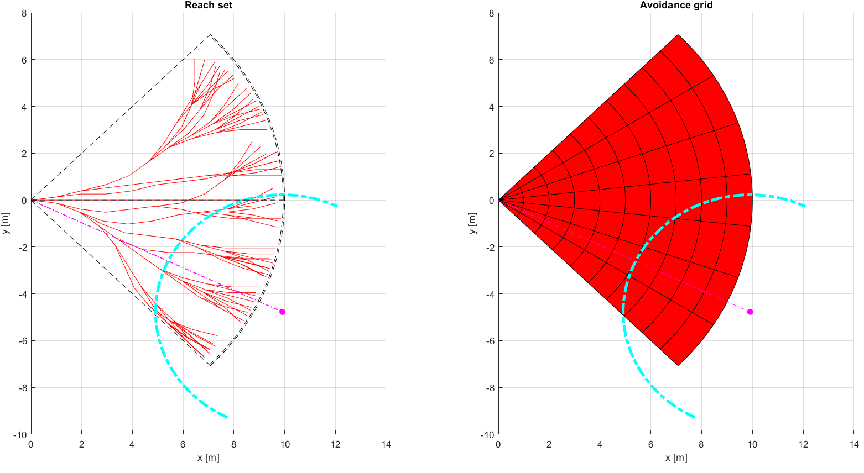
Enforce Safety Margin (6)

Slide 35
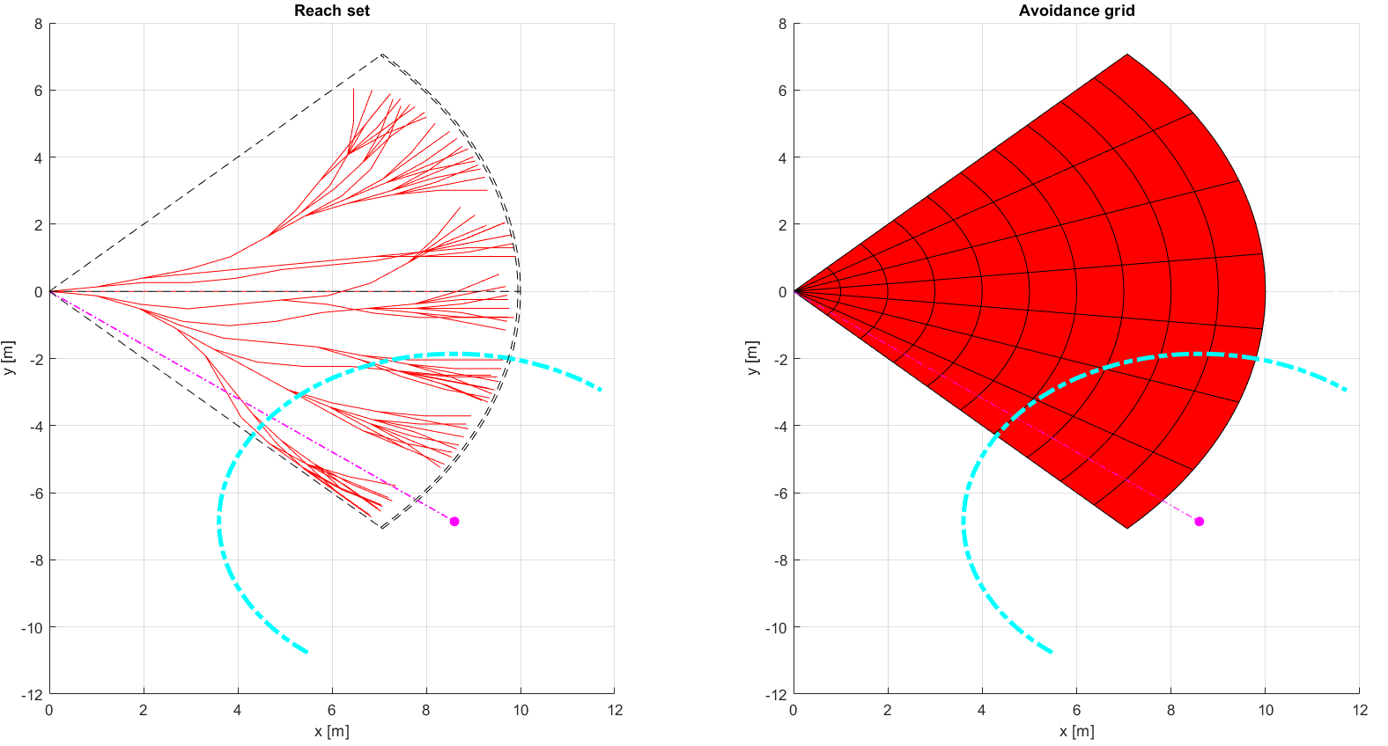
Enforce Safety Margin (7)

Slide 36
Rule: Detect Collision Cases

Slide 37
Rule: Resolve Collision Case
Include rule invocation on this slide, explain mechanism of chaining and multiple rules

Slide 38
Rule: Close Collision Case

Slide 39
Rule: Converging Manuever

Slide 40
Rule: Head On Approach

Slide 41
Rule: Overtake

Slide 42
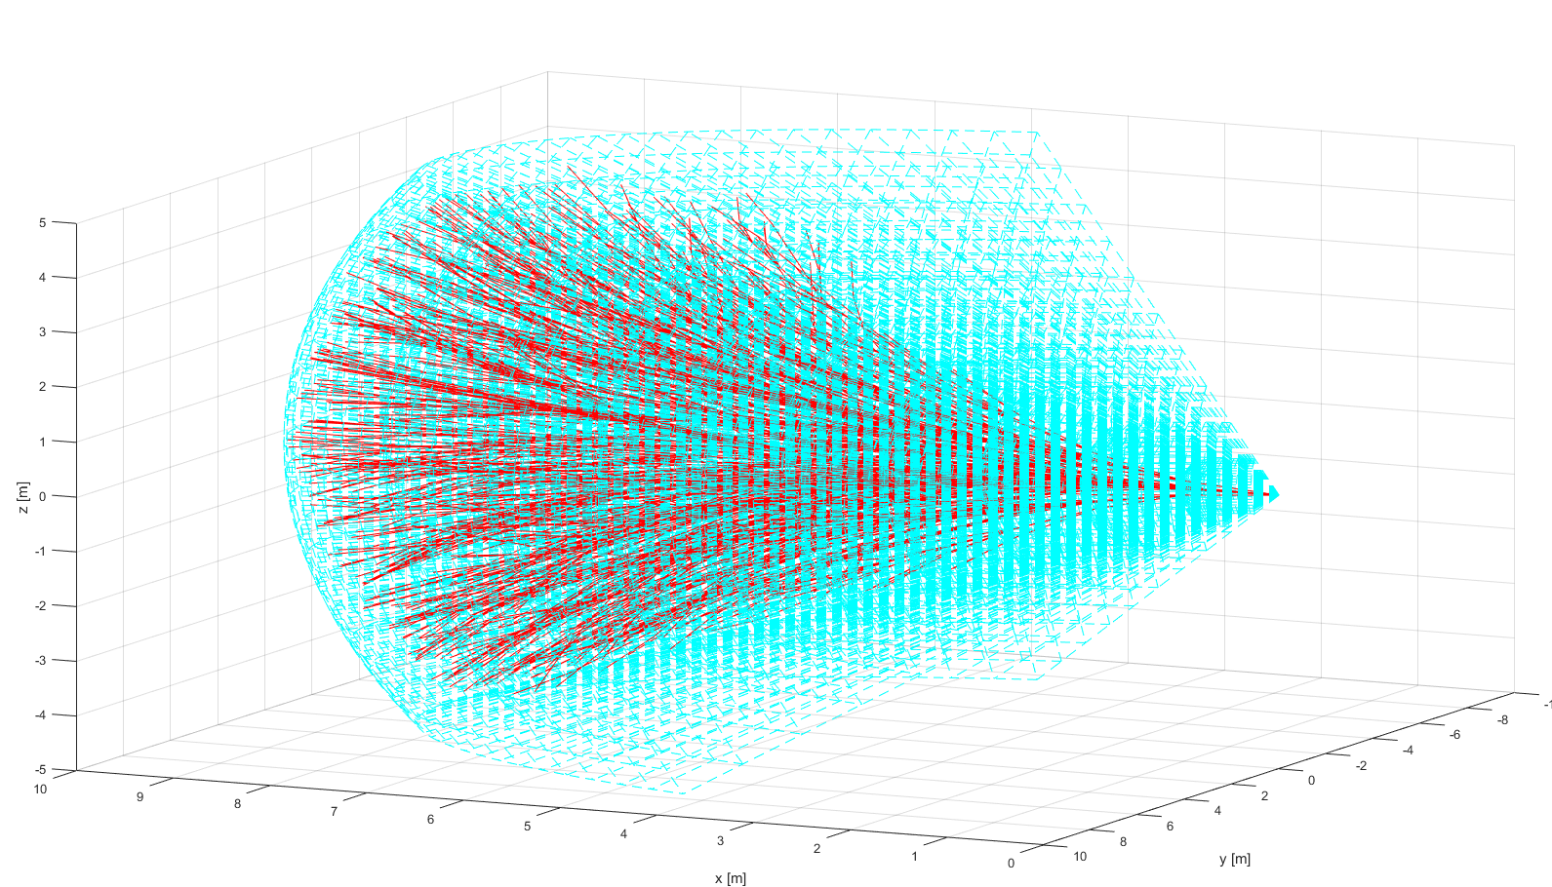
ACAS-XU Reach Set

Slide 43
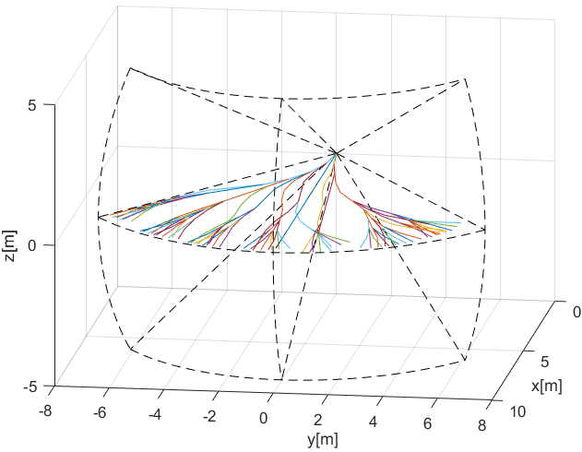
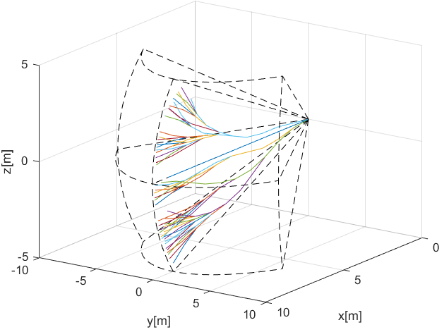
Standard Separations
Standard Separations are supported in other ACAS-X implementations as maneuver look-up tables, the trajectories are slightly diverged right (horizontal) and down (vertical) for support of standard TCAS II behavior and Rules of the Air implementation.
Horizontal Separation – standard separation in Flight Level area regardless of the altitude, horizontal separation would not break flight level therefore is preferred for conflict resolution.
Vertical separation – separation for aircrafts with better horizontal maneuverability.

Slide 44
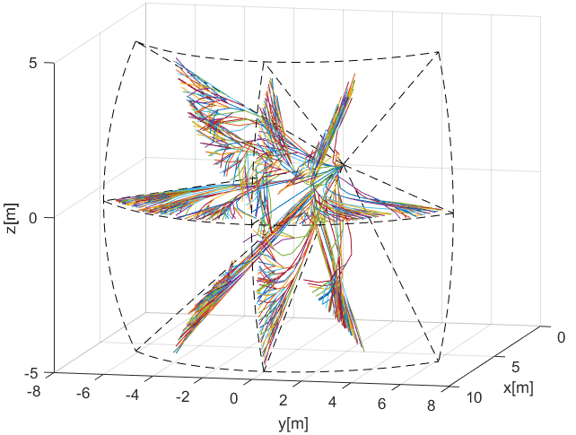
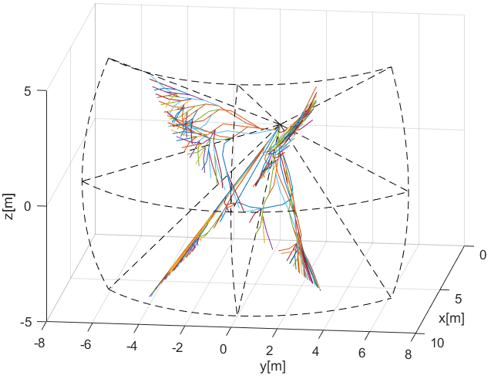
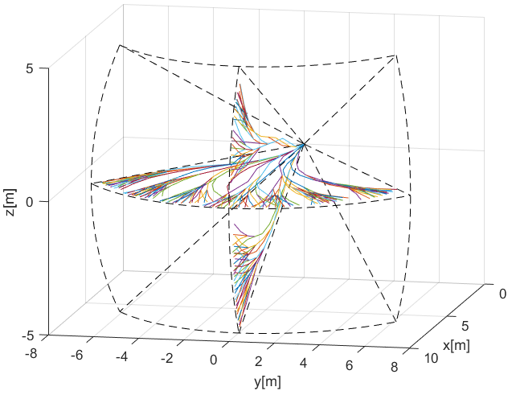
Combined Separations
Complete separations – containing horizontal vertical and tilted separations, closest to original Harmonic Reach set.
Horizontal/Vertical – containing horizontal and vertical separations, close to original TCAS II.
Tilted Left/Tilted Right – ACAS-XU

Slide 45
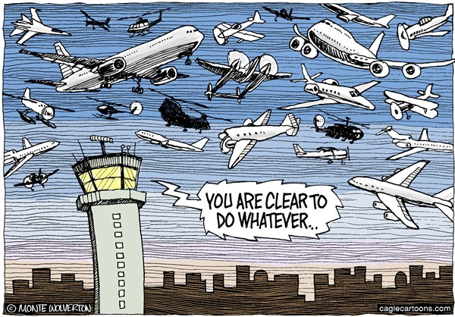

Emergency and Planned Avoidance

Slide 46
Standard Scenarios
Converging maneuver
Event Based
Situation Based
Head-On approach
Event Based
Situation Based
Multiple Collision Cases
Event Based
Situation Based
Overtake
Situation Based

Slide 47
Converging Manuever

Slide 48

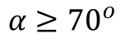
Converging Maneuver - Trigger
$$α≥{70}^{o}$$
The aircraft on other right, has the right of the way

Slide 49
Converging Maneuver - Resolution
Turn right and stay away from approaching aircraft

Slide 50
Converging Maneuver – Leave condition
Return to original path behind other aircraft

Slide 51
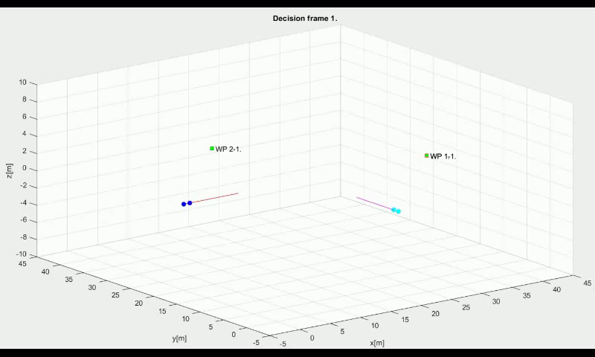
Emergency: Converging Maneuver

Slide 52
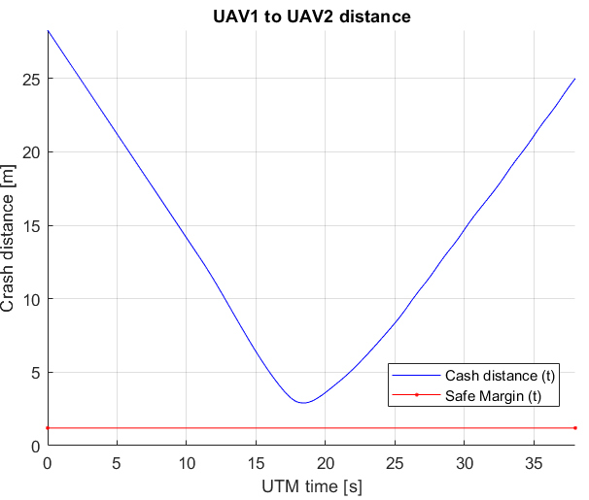
Emergency: Converging Maneuver

Slide 53
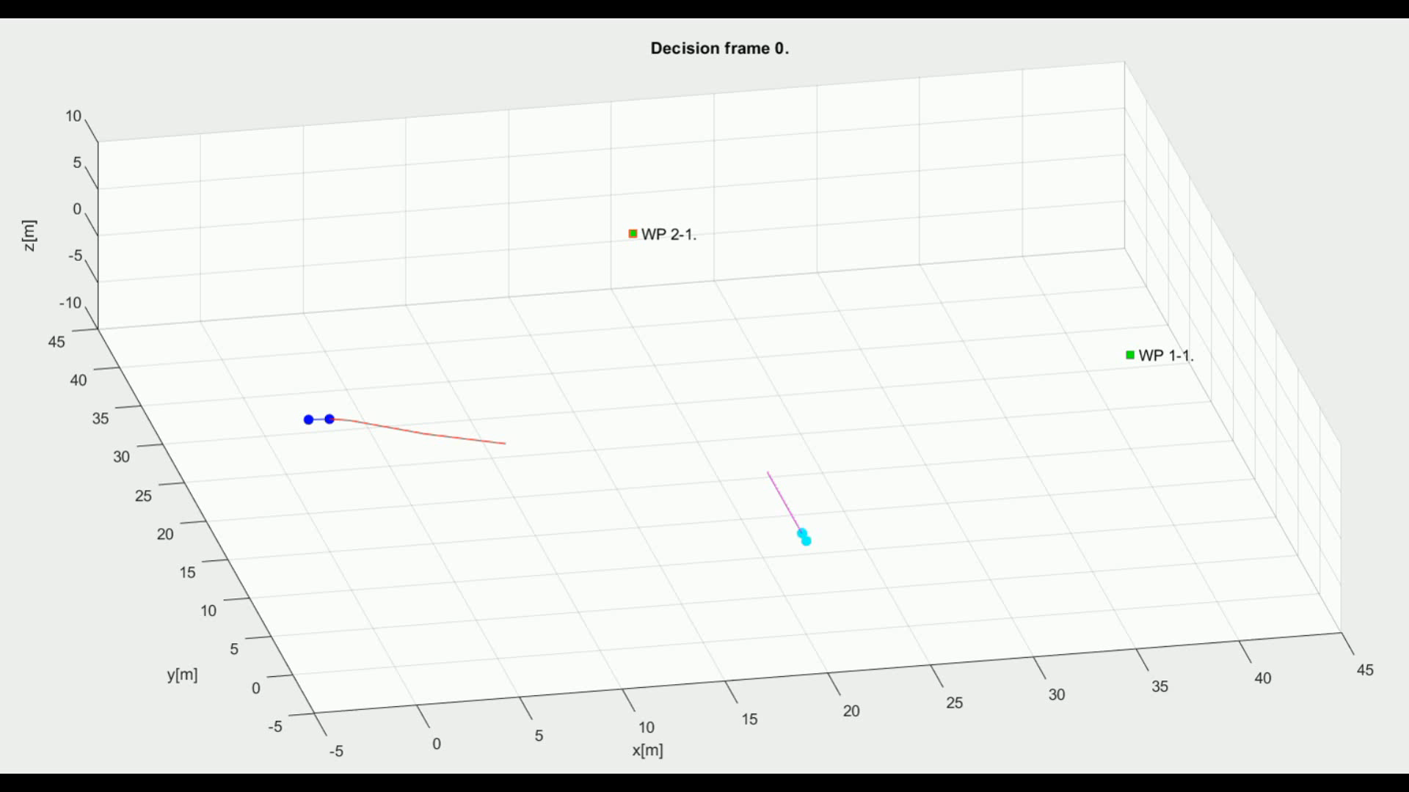
Rule-Based: Converging Maneuver

Slide 54
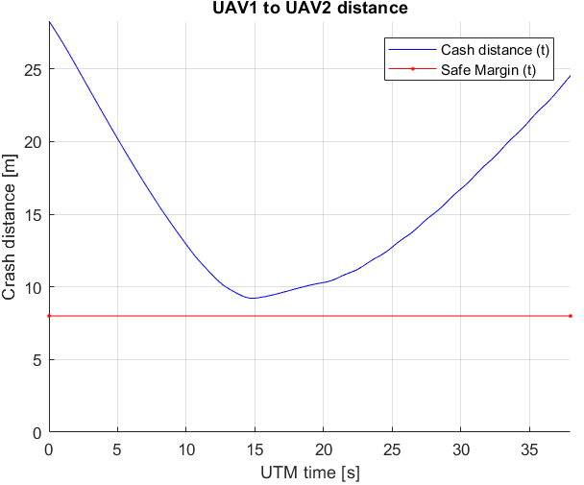
Rule-Based: Converging Maneuver

Slide 55
Head On Approach

Slide 56
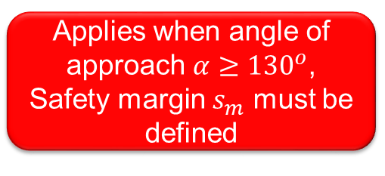
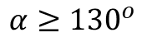
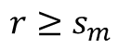
Head On Approach - Trigger
$$α≥{130}^{o}$$
$$r≥s_{m}$$
Applies when angle of approach $α≥{130}^{o}$, Safety margin $s_{m}$ must be defined

Slide 57
Head On Approach - Resolution
$$r≥s_{m}$$
Both vehicles are taking right side avoidance

Slide 58
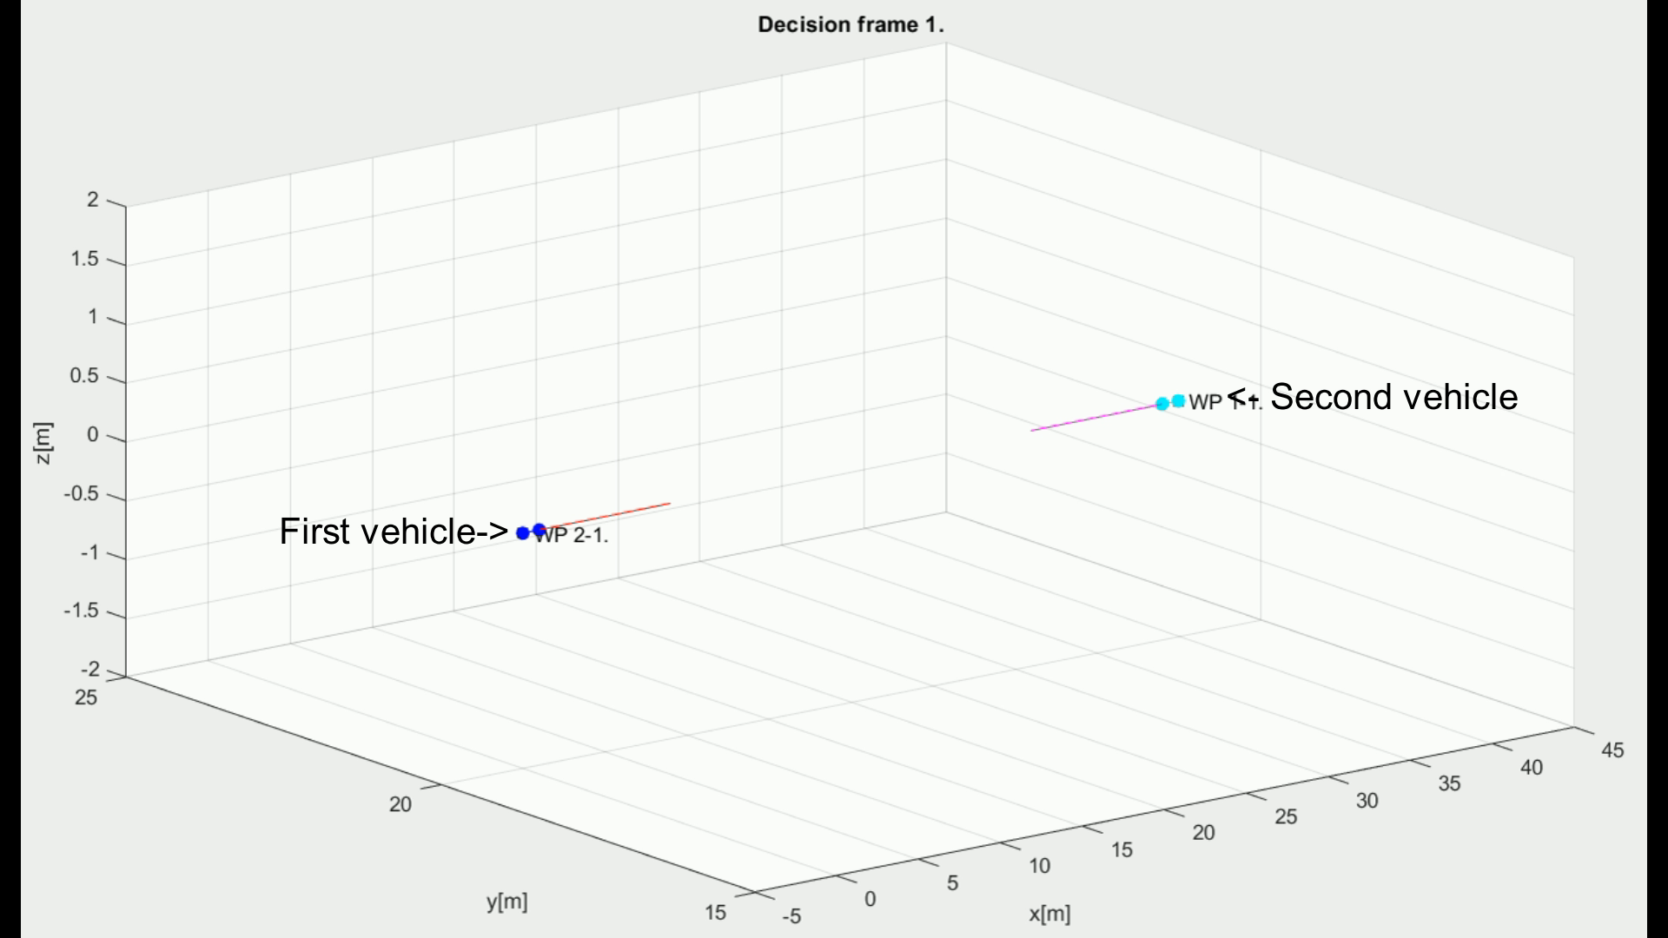
Emergency: Head On Approach

Slide 59
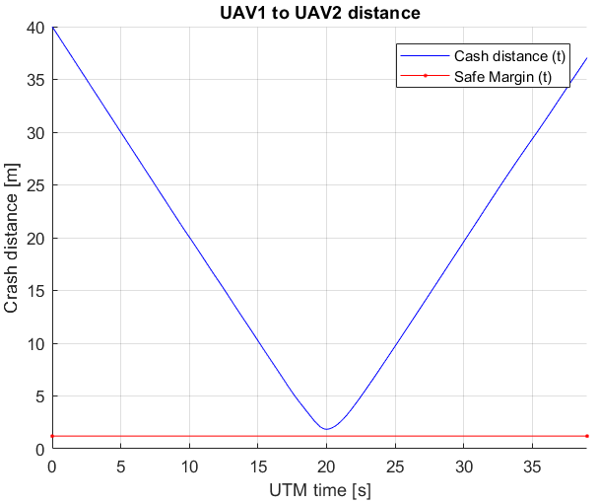
Emergency: Head On Approach

Slide 60
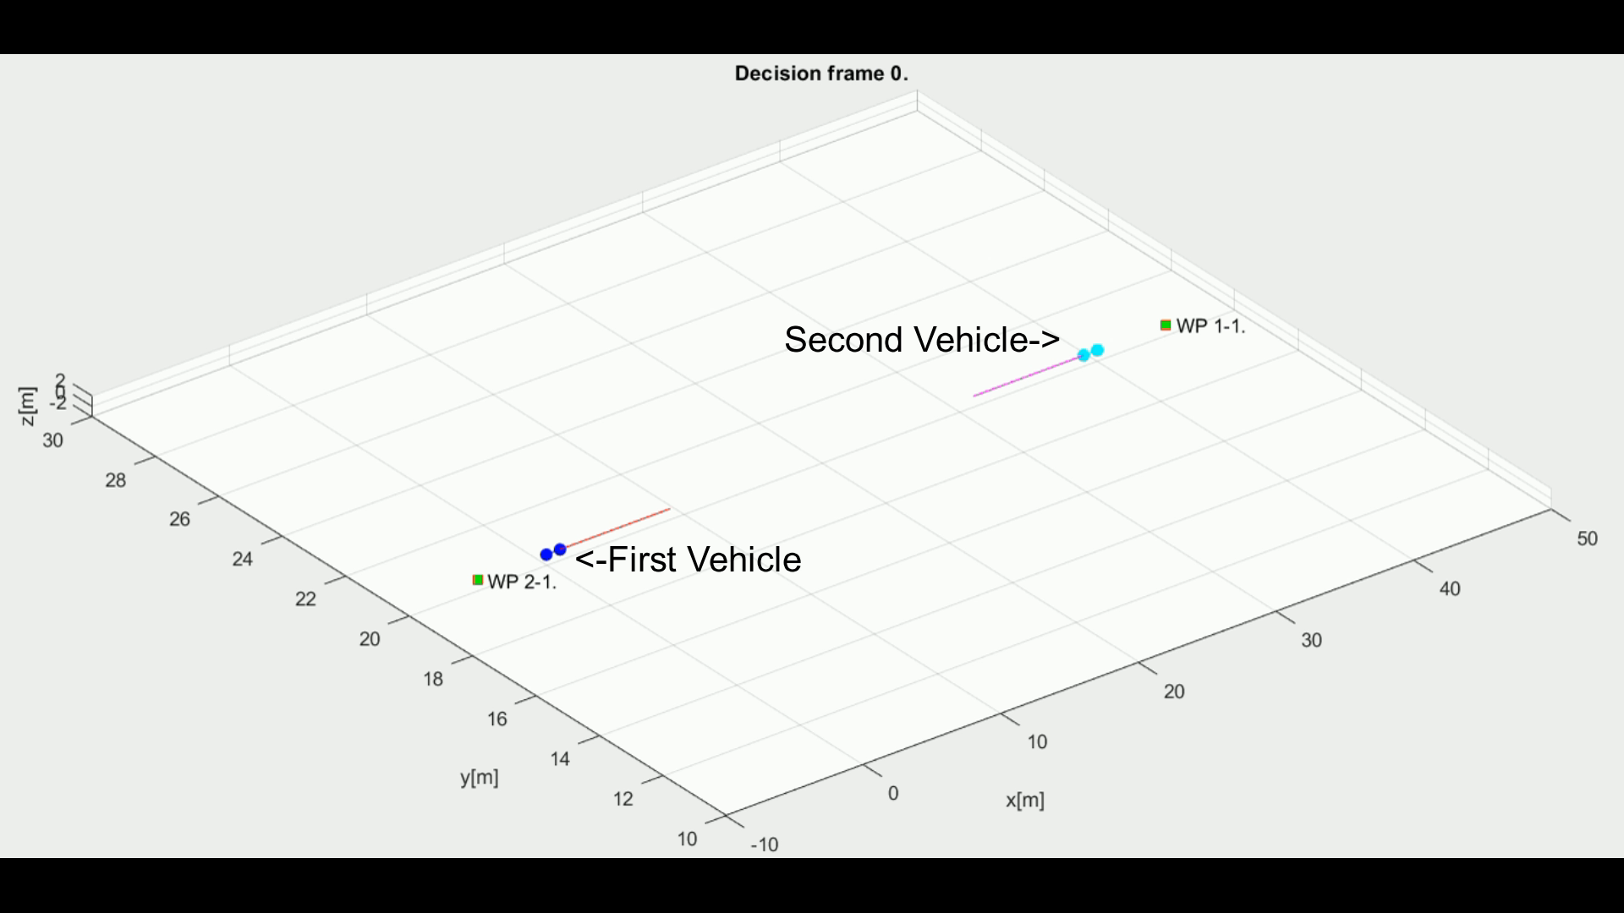
Rule-Based: Head On Approach

Slide 61
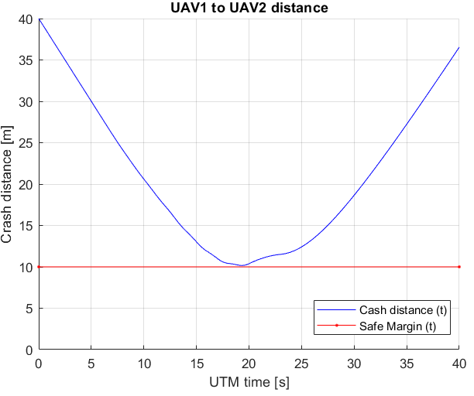
Rule-Based: Head On Approach

Slide 62
Multiple Collision Cases

Slide 63
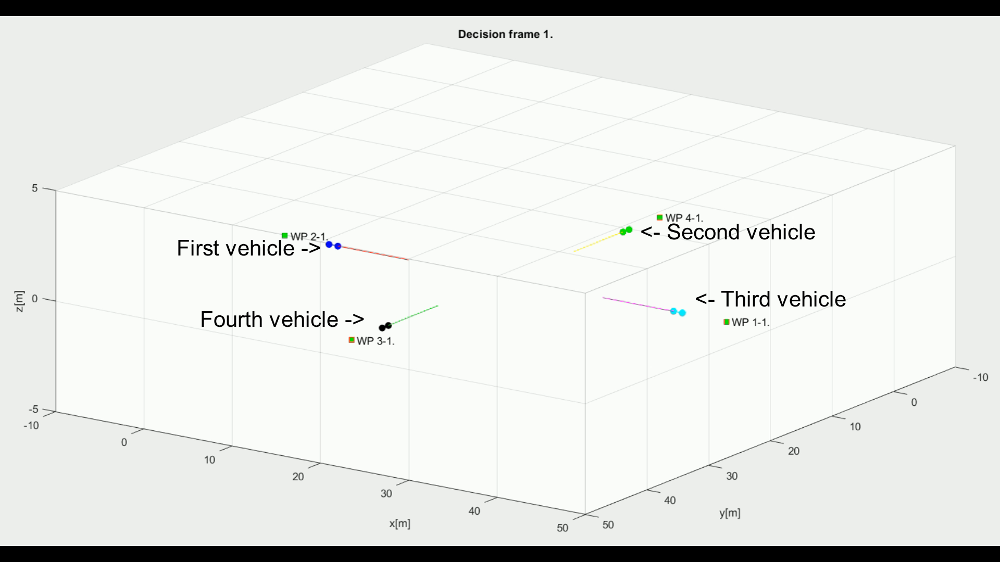
Emergency: Multiple Collision Cases

Slide 64
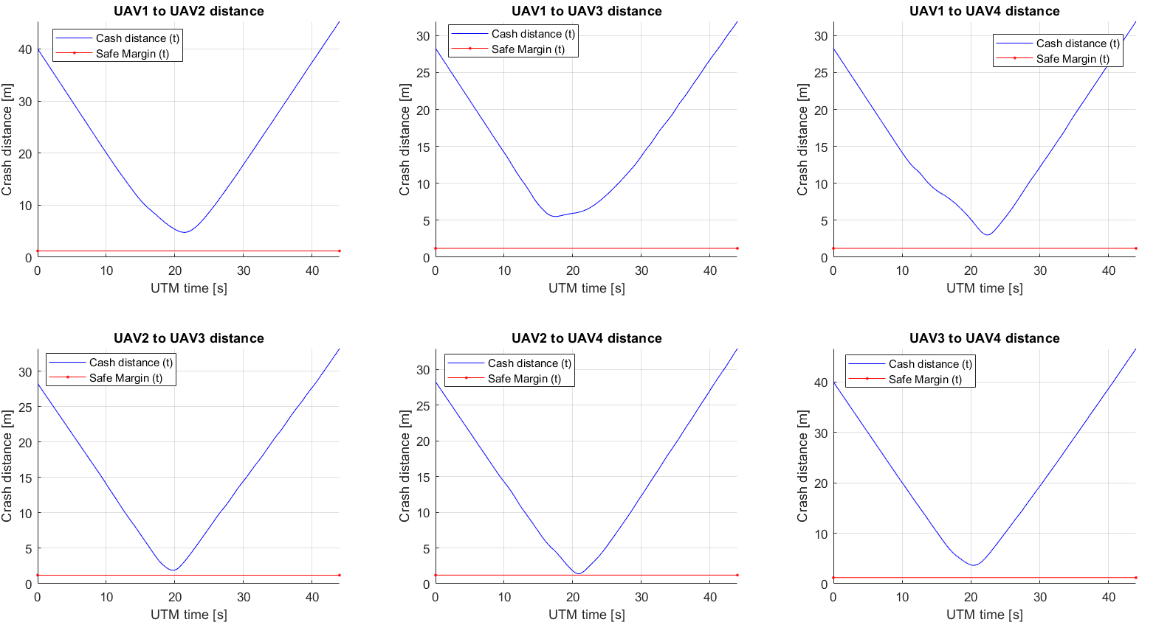
Emergency: Multiple Collision Cases

Slide 65
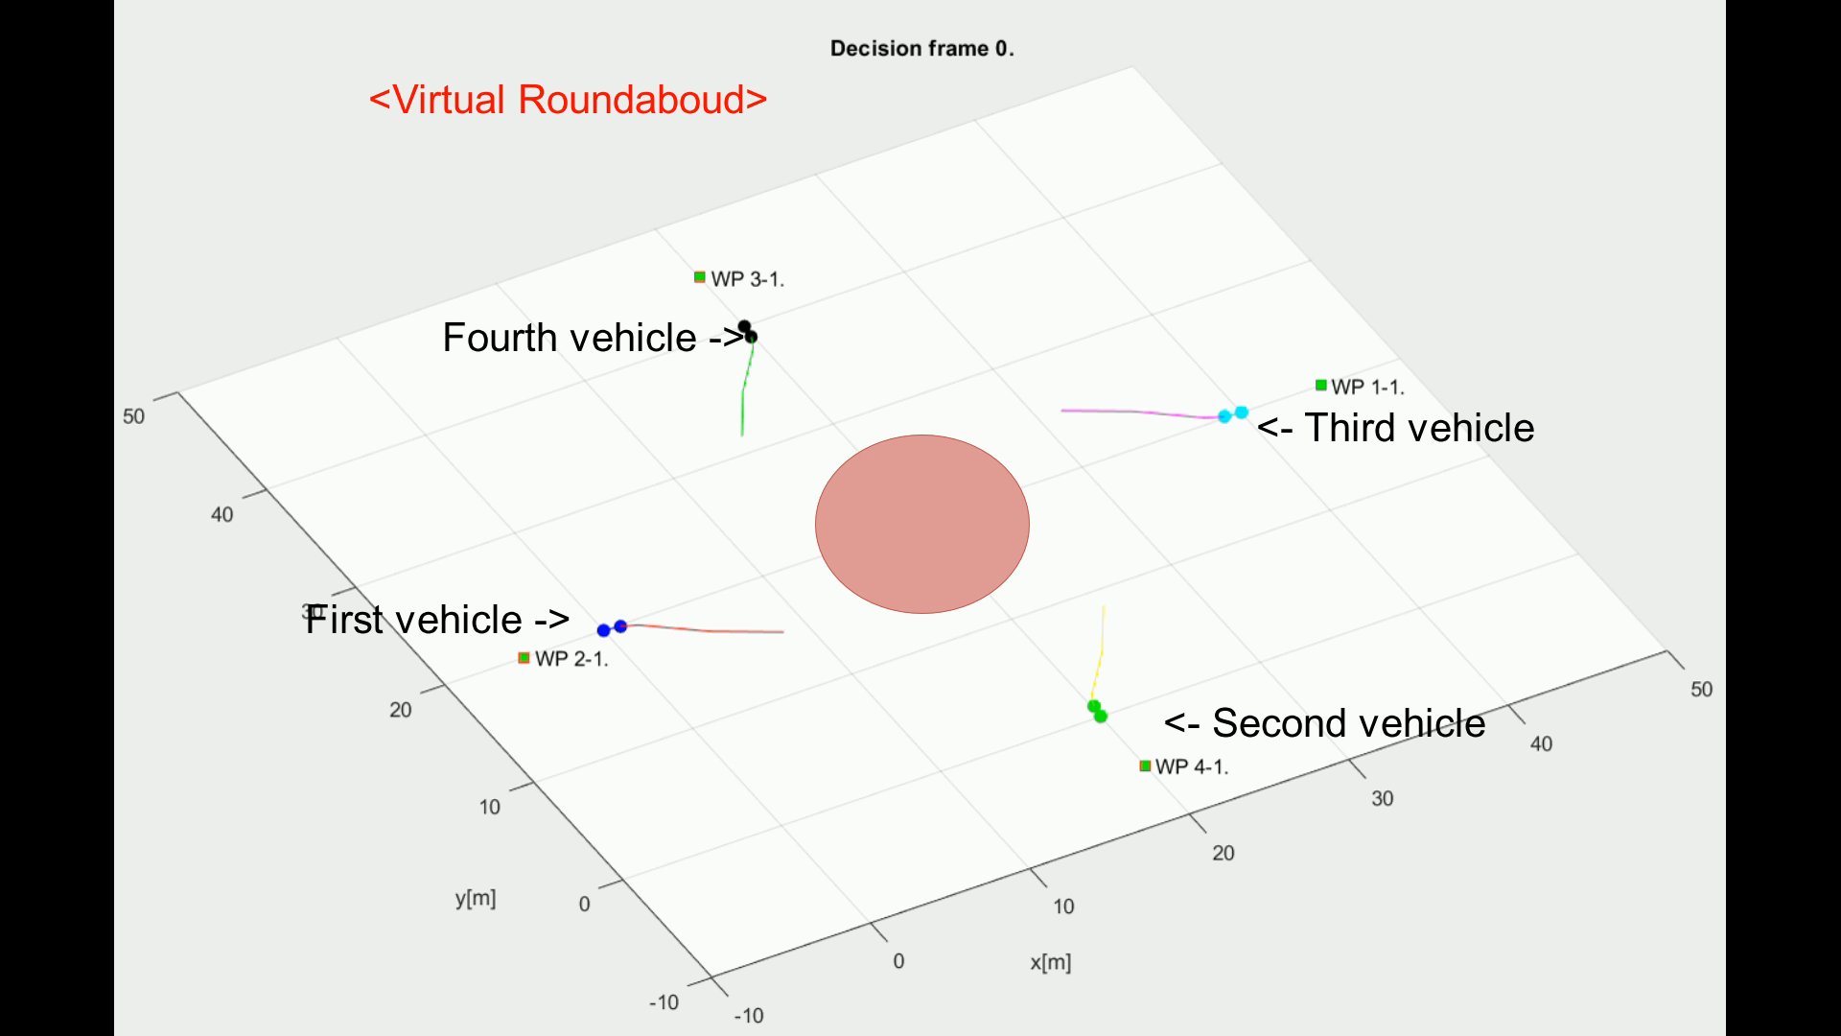
Rule-Based: Multiple Collision Cases

Slide 66
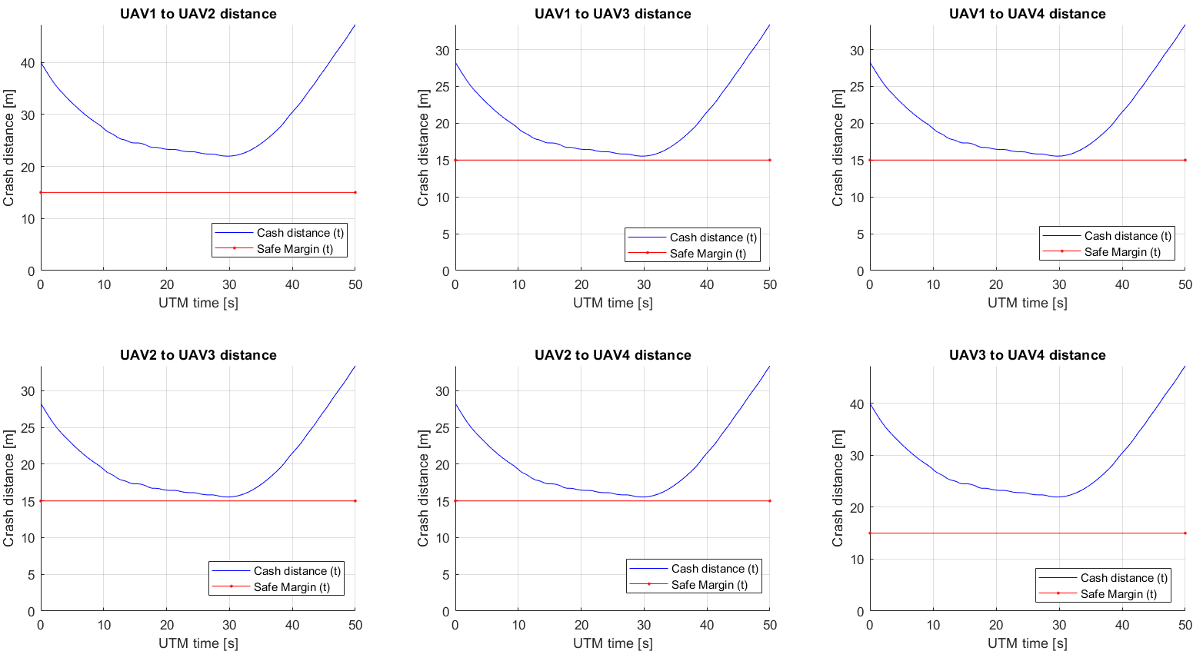
Rule-Based: Multiple Collision Cases

Slide 67
Overtake Maneuver

Slide 68
Overtake Maneuver - Trigger
The aircraft being overtaken has the right of the way

Slide 69
Overtake Maneuver - Resolution
Overtake is executed from right

Slide 70
Overtake Maneuver – Leave Condition
Overtake rule may apply only when well clear condition is guaranteed

Slide 71
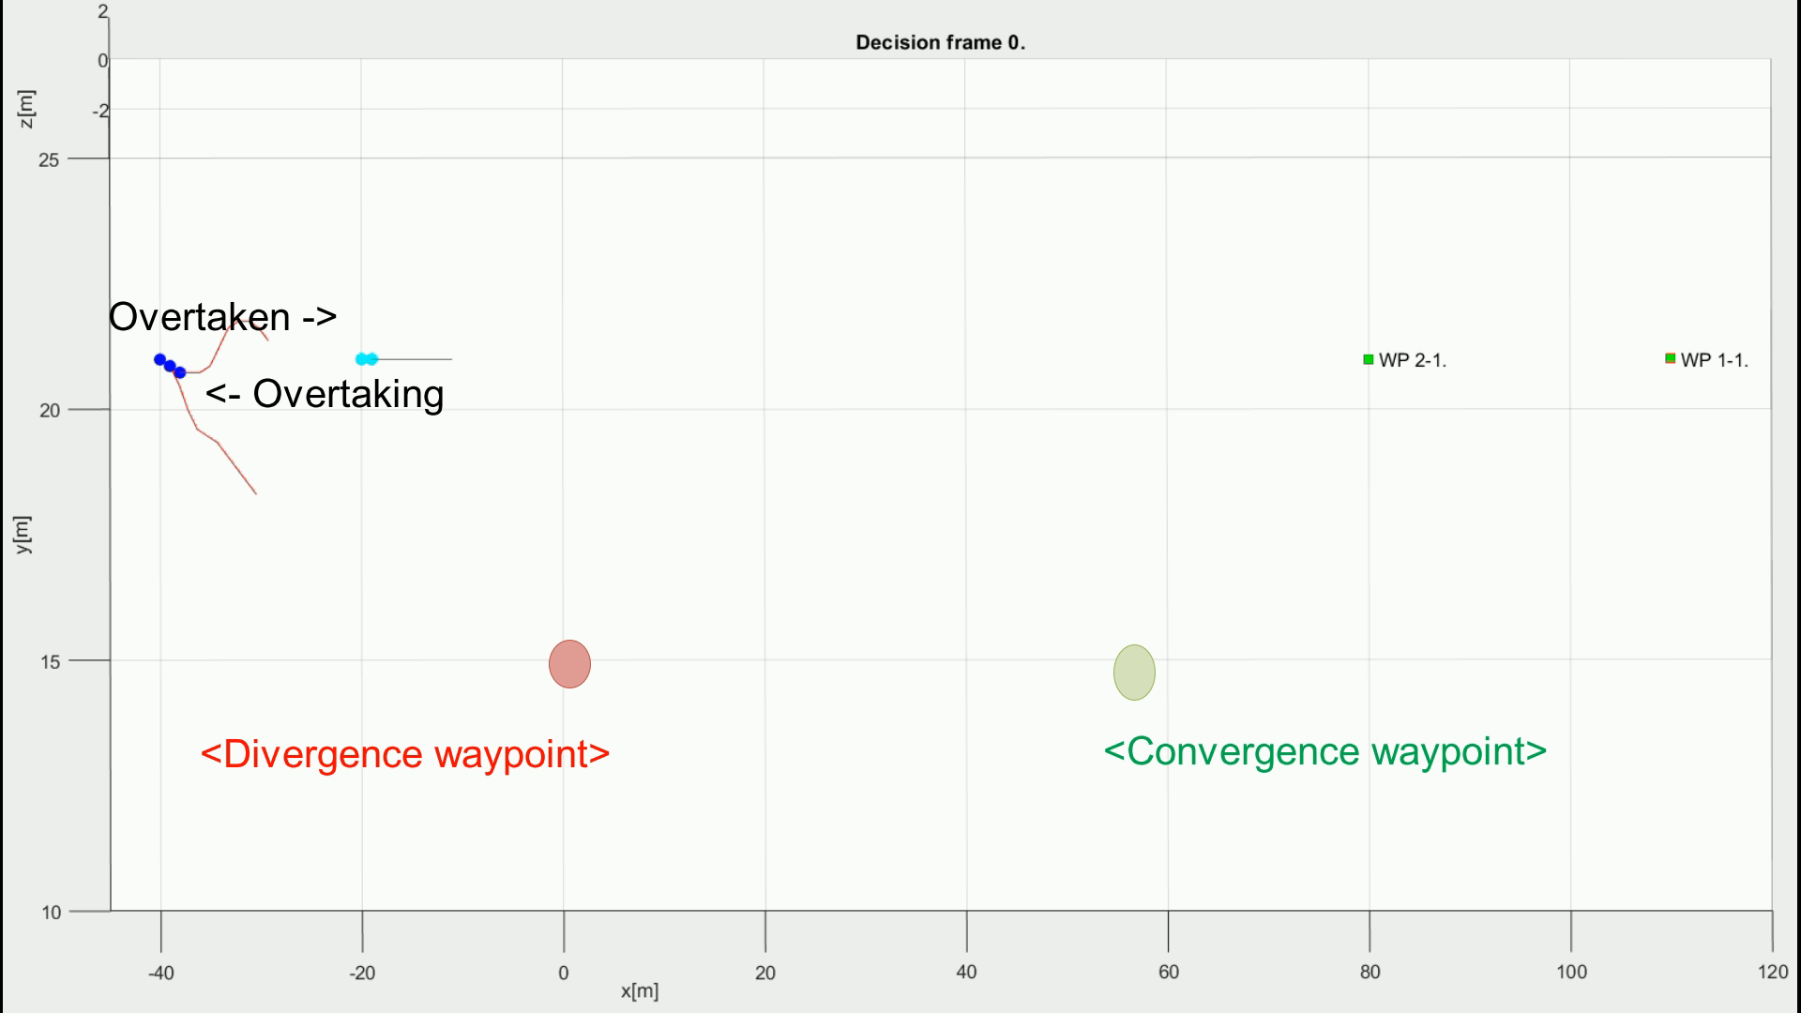
Rule-Based: Overtake Maneuver (3x speed)

Slide 72
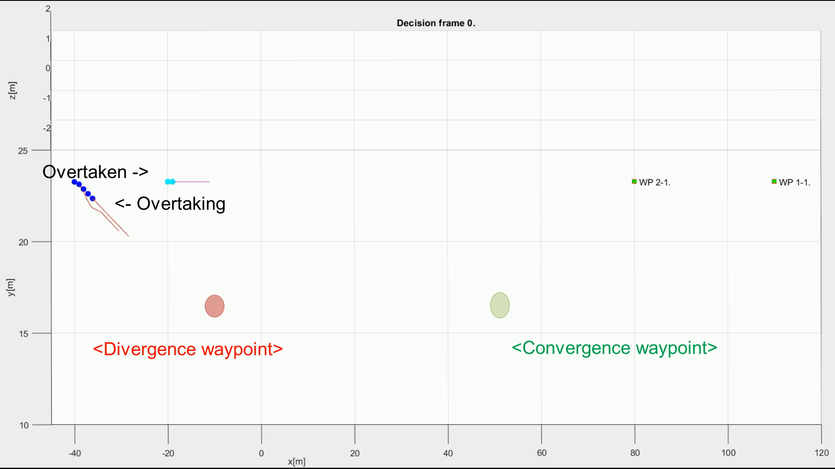
Rule-Based: Overtake Maneuver (3x Speed)

Slide 73
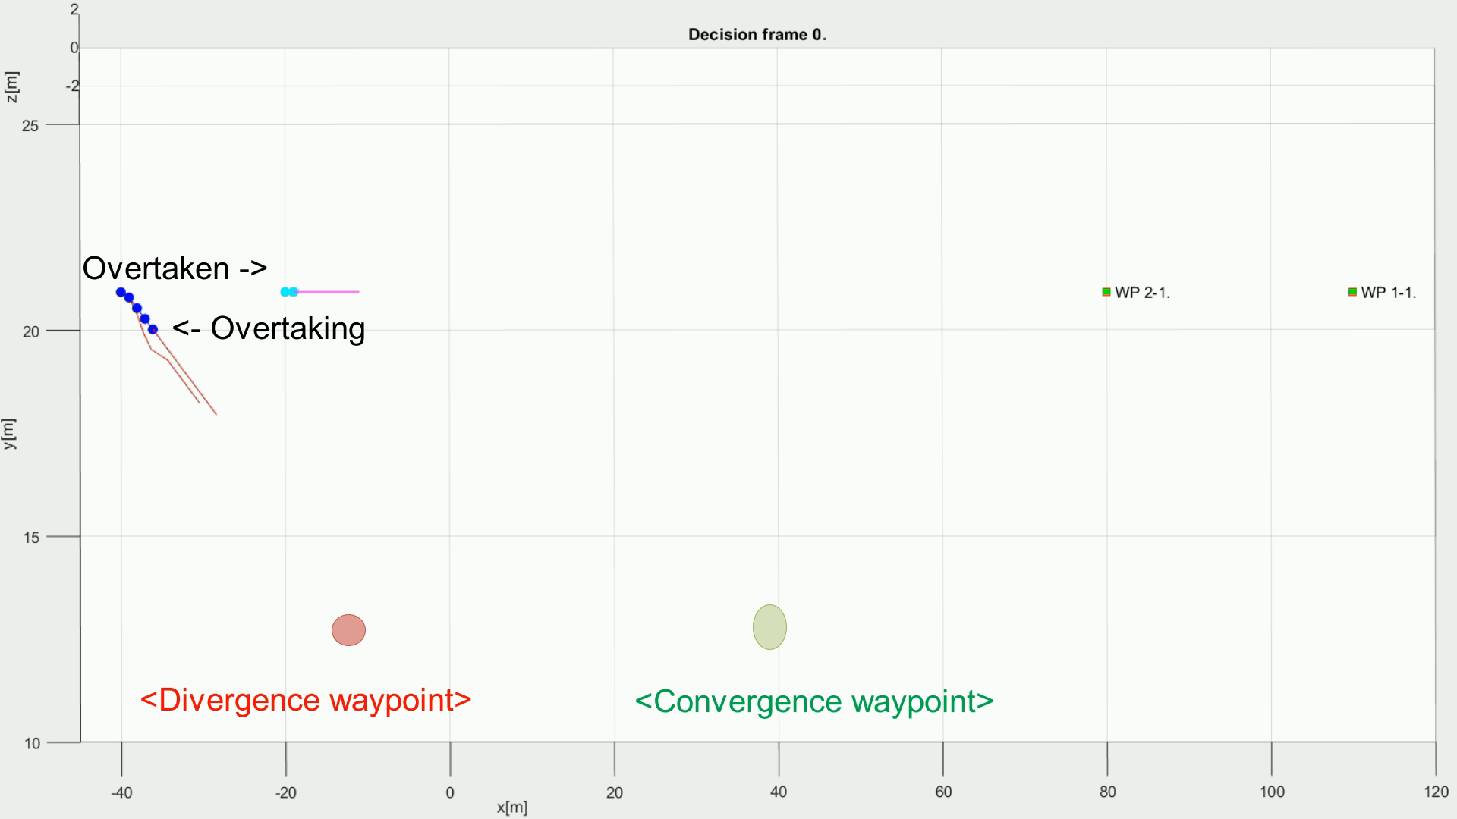
Rule-Based: Overtake Maneuver (4x Speed)

Slide 74
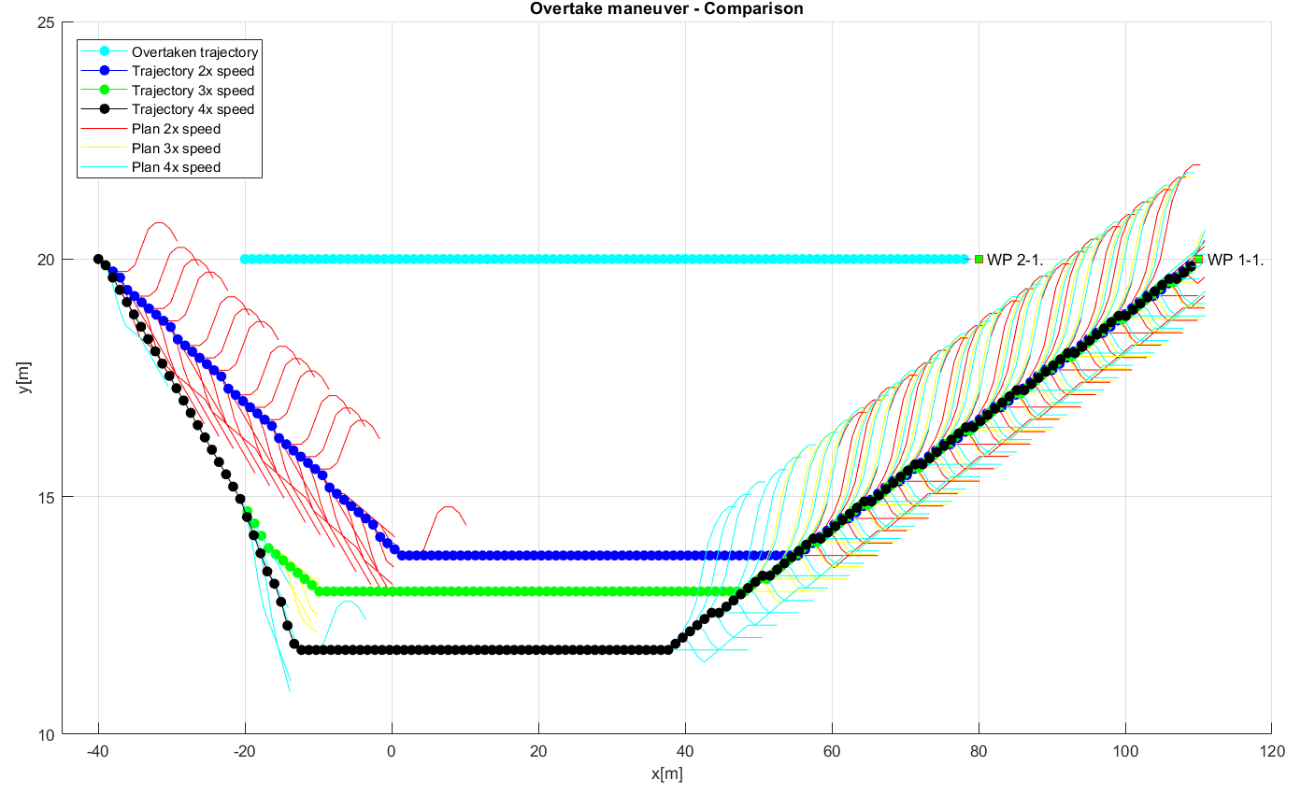
Rule-Based: Overtake Maneuver (Comparison)

Slide 75
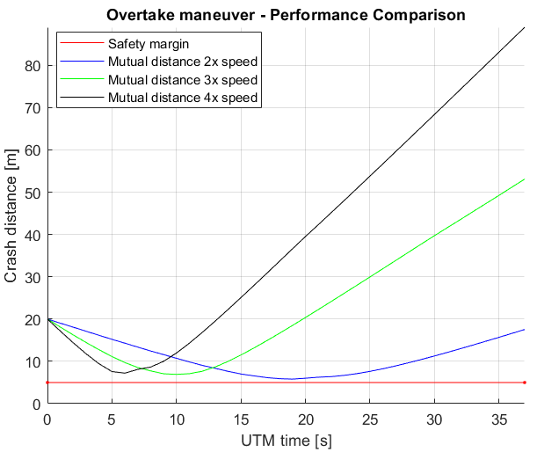
Rule-Based: Overtake Maneuver (Margins)

Slide 76




Q&A Session

